Slide 1
Chapter 4 section 2 & 3
Article IV in the Constitution

Slide 2
ARTICLE IV
Section 1.
Full faith and credit shall be given in each state to the public acts, records, and judicial proceedings of every other state. And the Congress may by general laws prescribe the manner in which such acts, records, and proceedings shall be proved, and the effect thereof.
Section 2.
The citizens of each state shall be entitled to all privileges and immunities of citizens in the several states.
A person charged in any state with treason, felony, or other crime, who shall flee from justice, and be found in another state, shall on demand of the executive authority of the state from which he fled, be delivered up, to be removed to the state having jurisdiction of the crime.
No person held to service or labor in one state, under the laws thereof, escaping into another, shall, in consequence of any law or regulation therein, be discharged from such service or labor, but shall be delivered up on claim of the party to whom such service or labor may be due.

Slide 3
Section 3.
New states may be admitted by the Congress into this union; but no new states shall be formed or erected within the jurisdiction of any other state; nor any state be formed by the junction of two or more states, or parts of states, without the consent of the legislatures of the states concerned as well as of the Congress.
The Congress shall have power to dispose of and make all needful rules and regulations respecting the territory or other property belonging to the United States; and nothing in this Constitution shall be so construed as to prejudice any claims of the United States, or of any particular state.
Section 4.
The United States shall guarantee to every state in this union a republican form of government, and shall protect each of them against invasion; and on application of the legislature, or of the executive (when the legislature cannot be convened) against domestic violence.

Slide 4
Section 10.
No state shall enter into any treaty, alliance, or confederation; grant letters of marque and reprisal; coin money; emit bills of credit; make anything but gold and silver coin a tender in payment of debts; pass any bill of attainder, ex post facto law, or law impairing the obligation of contracts, or grant any title of nobility.
No state shall, without the consent of the Congress, lay any imposts or duties on imports or exports, except what may be absolutely necessary for executing its inspection laws: and the net produce of all duties and imposts, laid by any state on imports or exports, shall be for the use of the treasury of the United States; and all such laws shall be subject to the revision and control of the Congress.
No state shall, without the consent of Congress, lay any duty of tonnage, keep troops, or ships of war in time of peace, enter into any agreement or compact with another state, or with a foreign power, or engage in war, unless actually invaded, or in such imminent danger as will not admit of delay.

Slide 5
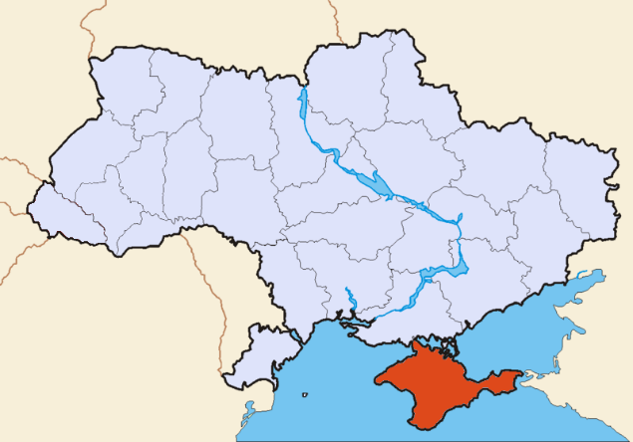
Promises from U.S. to States?

Slide 6
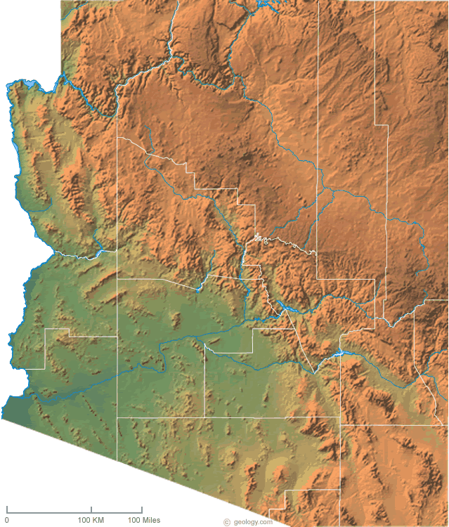
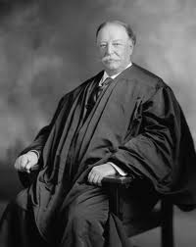
Becoming a State

Slide 7
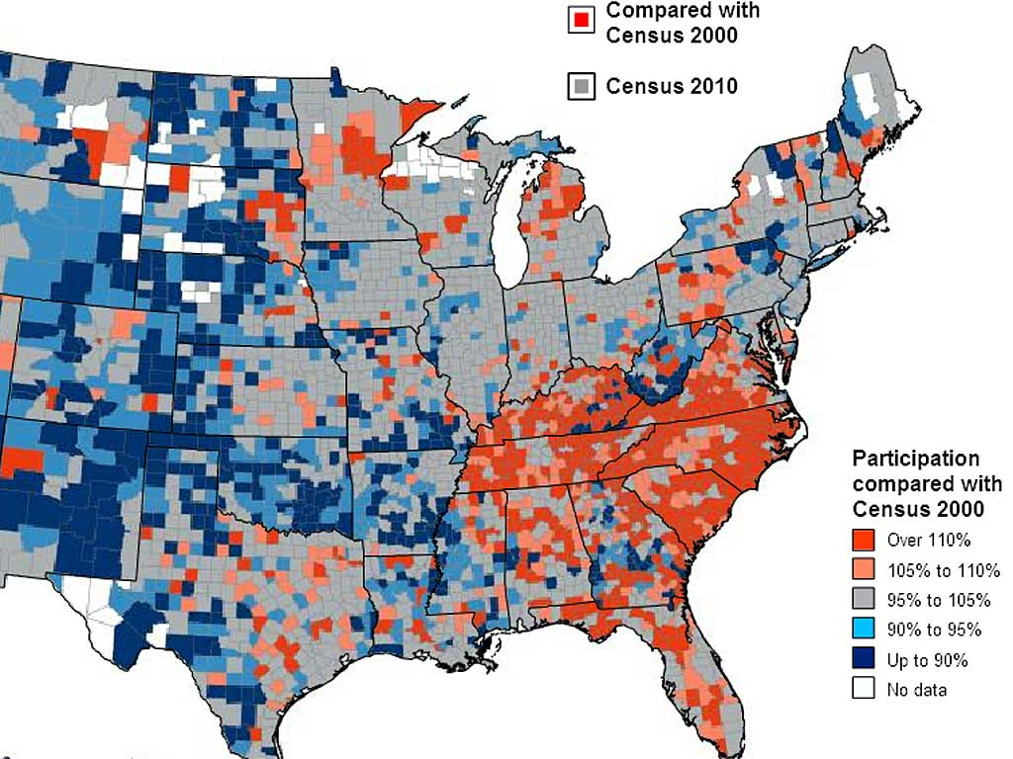
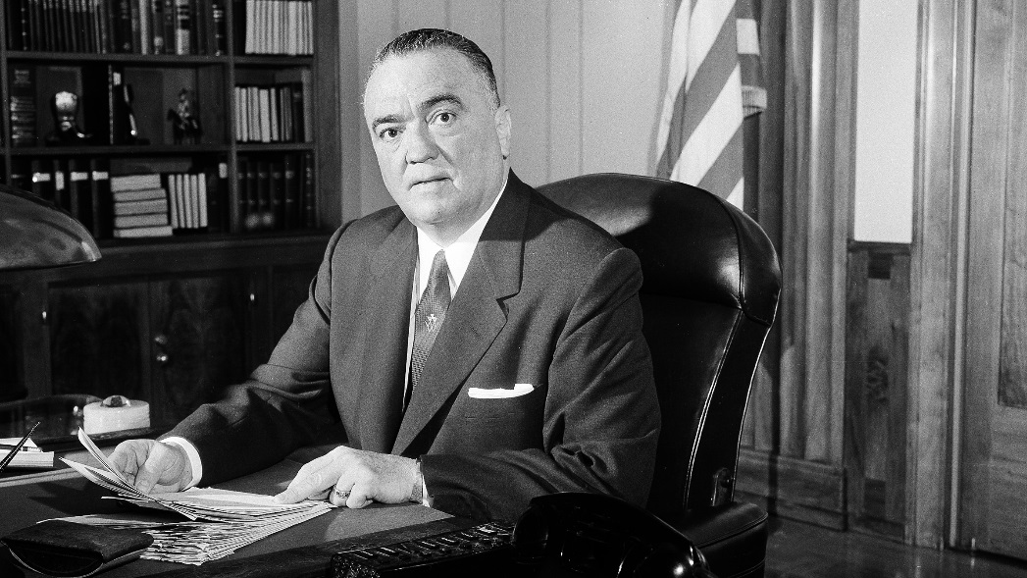
Help to States

Slide 8
States help out too!

Slide 9
Section 3
Interstate compacts
Full faith and credit: Nevada divorce laws (Williams v. NC)
extradition

